Slide 1
NC SBIR Celebration Summit
DoD SBIR Program
Presented by
Randy Simpson, COO
Randy.Simpson@TechOppConsulting.com | 540-744-5854
September 2021

Slide 2
Introduction to TechOpp Consulting

Slide 3
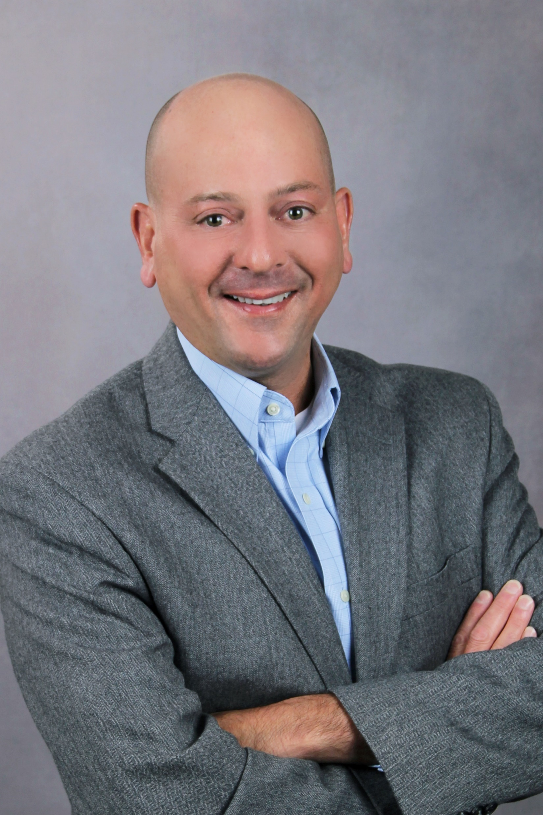

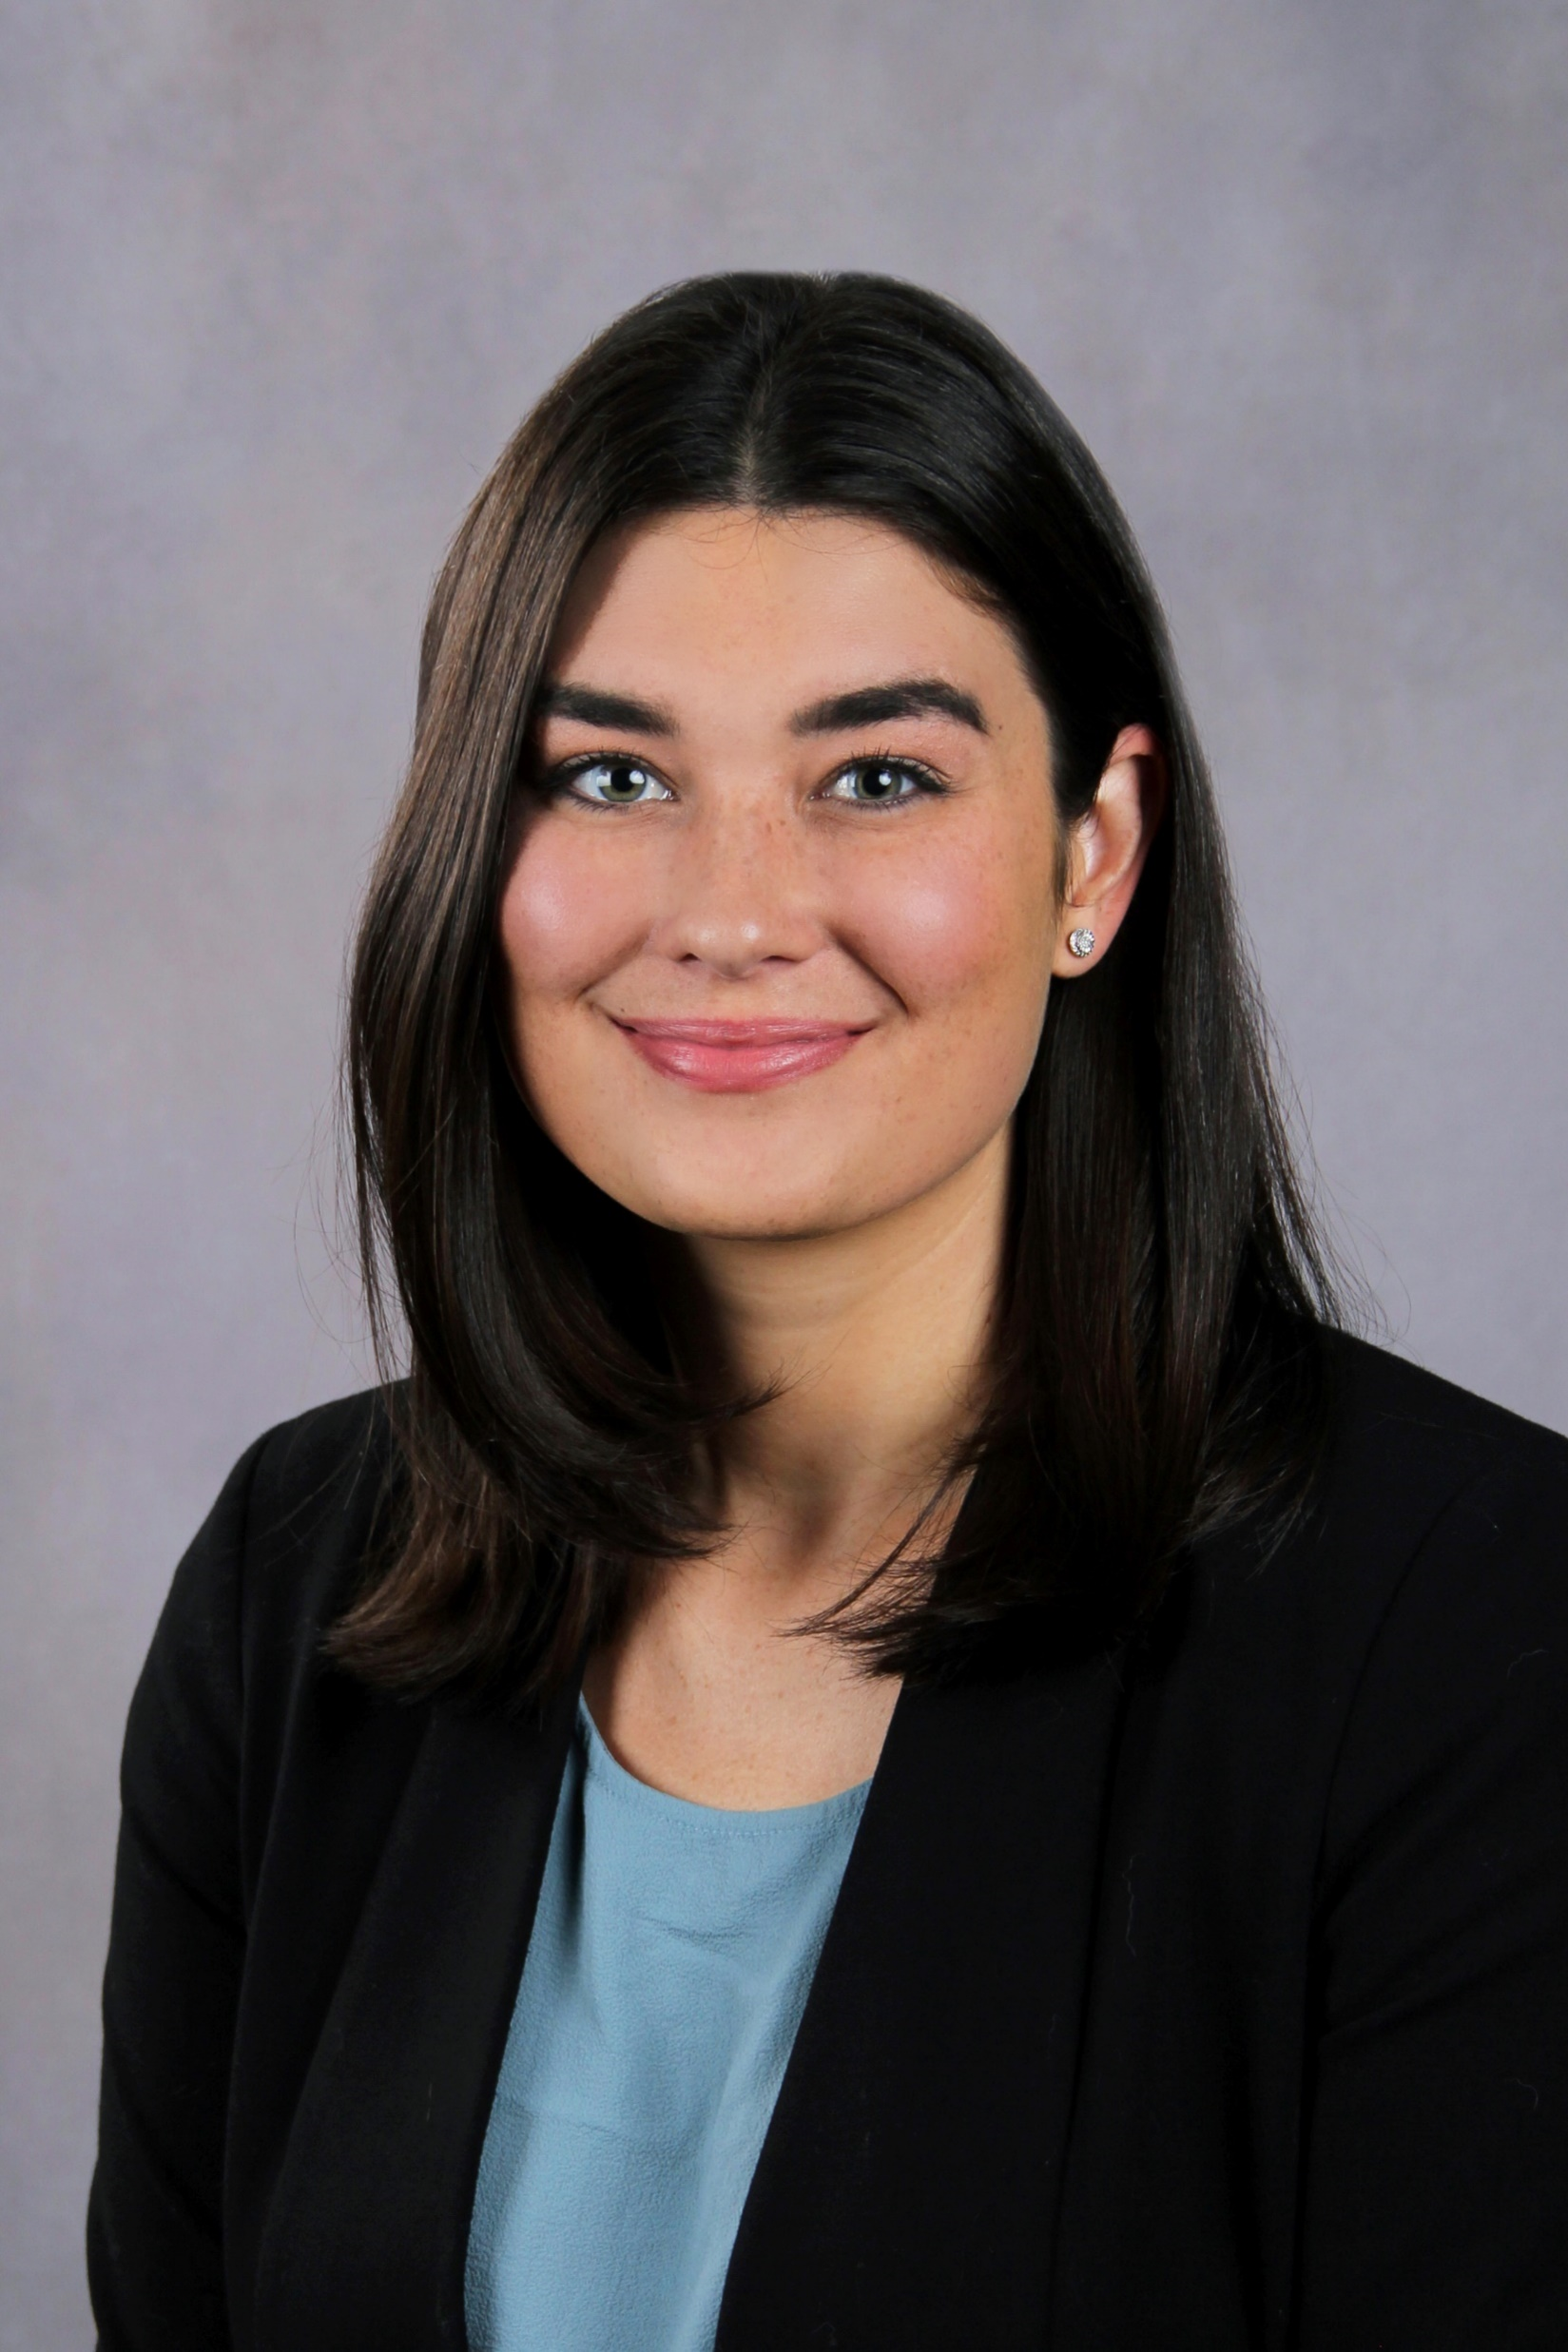

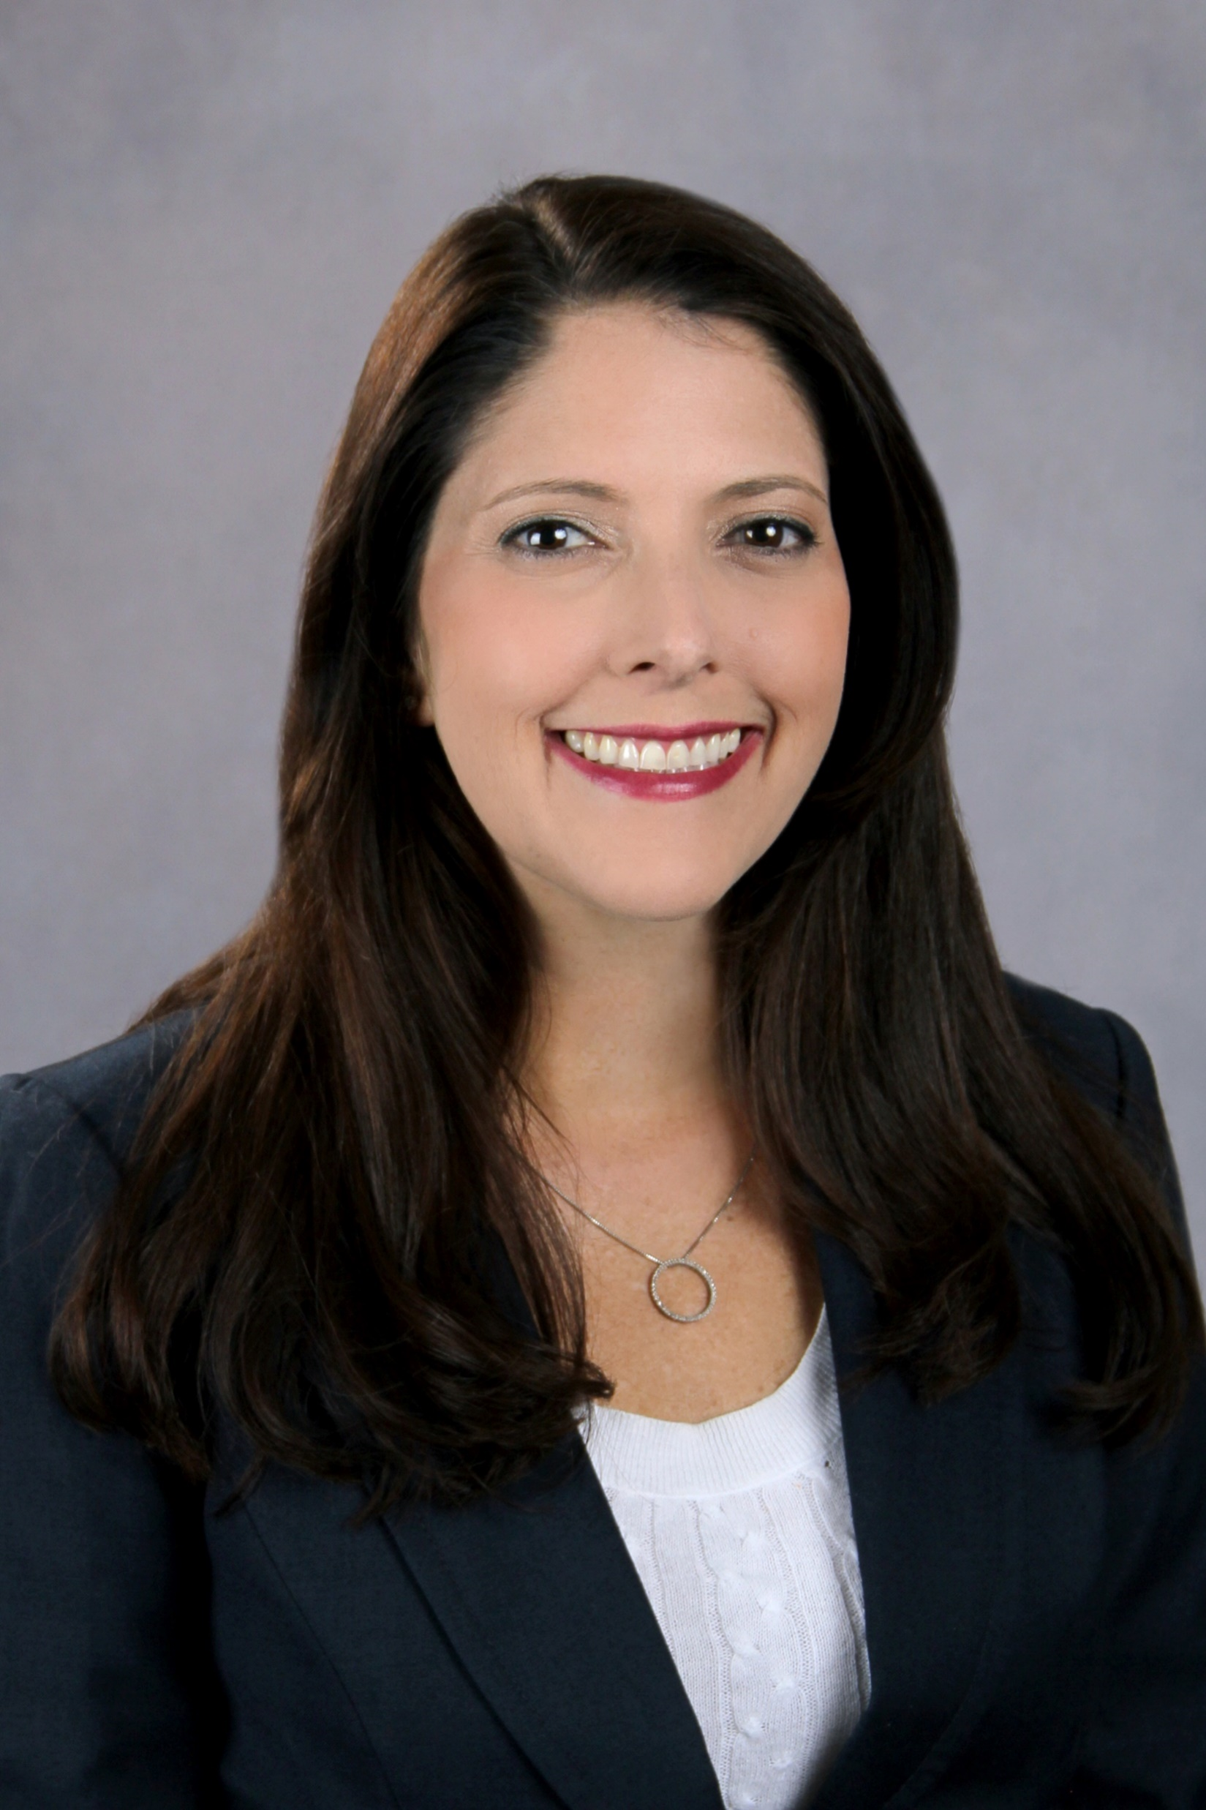
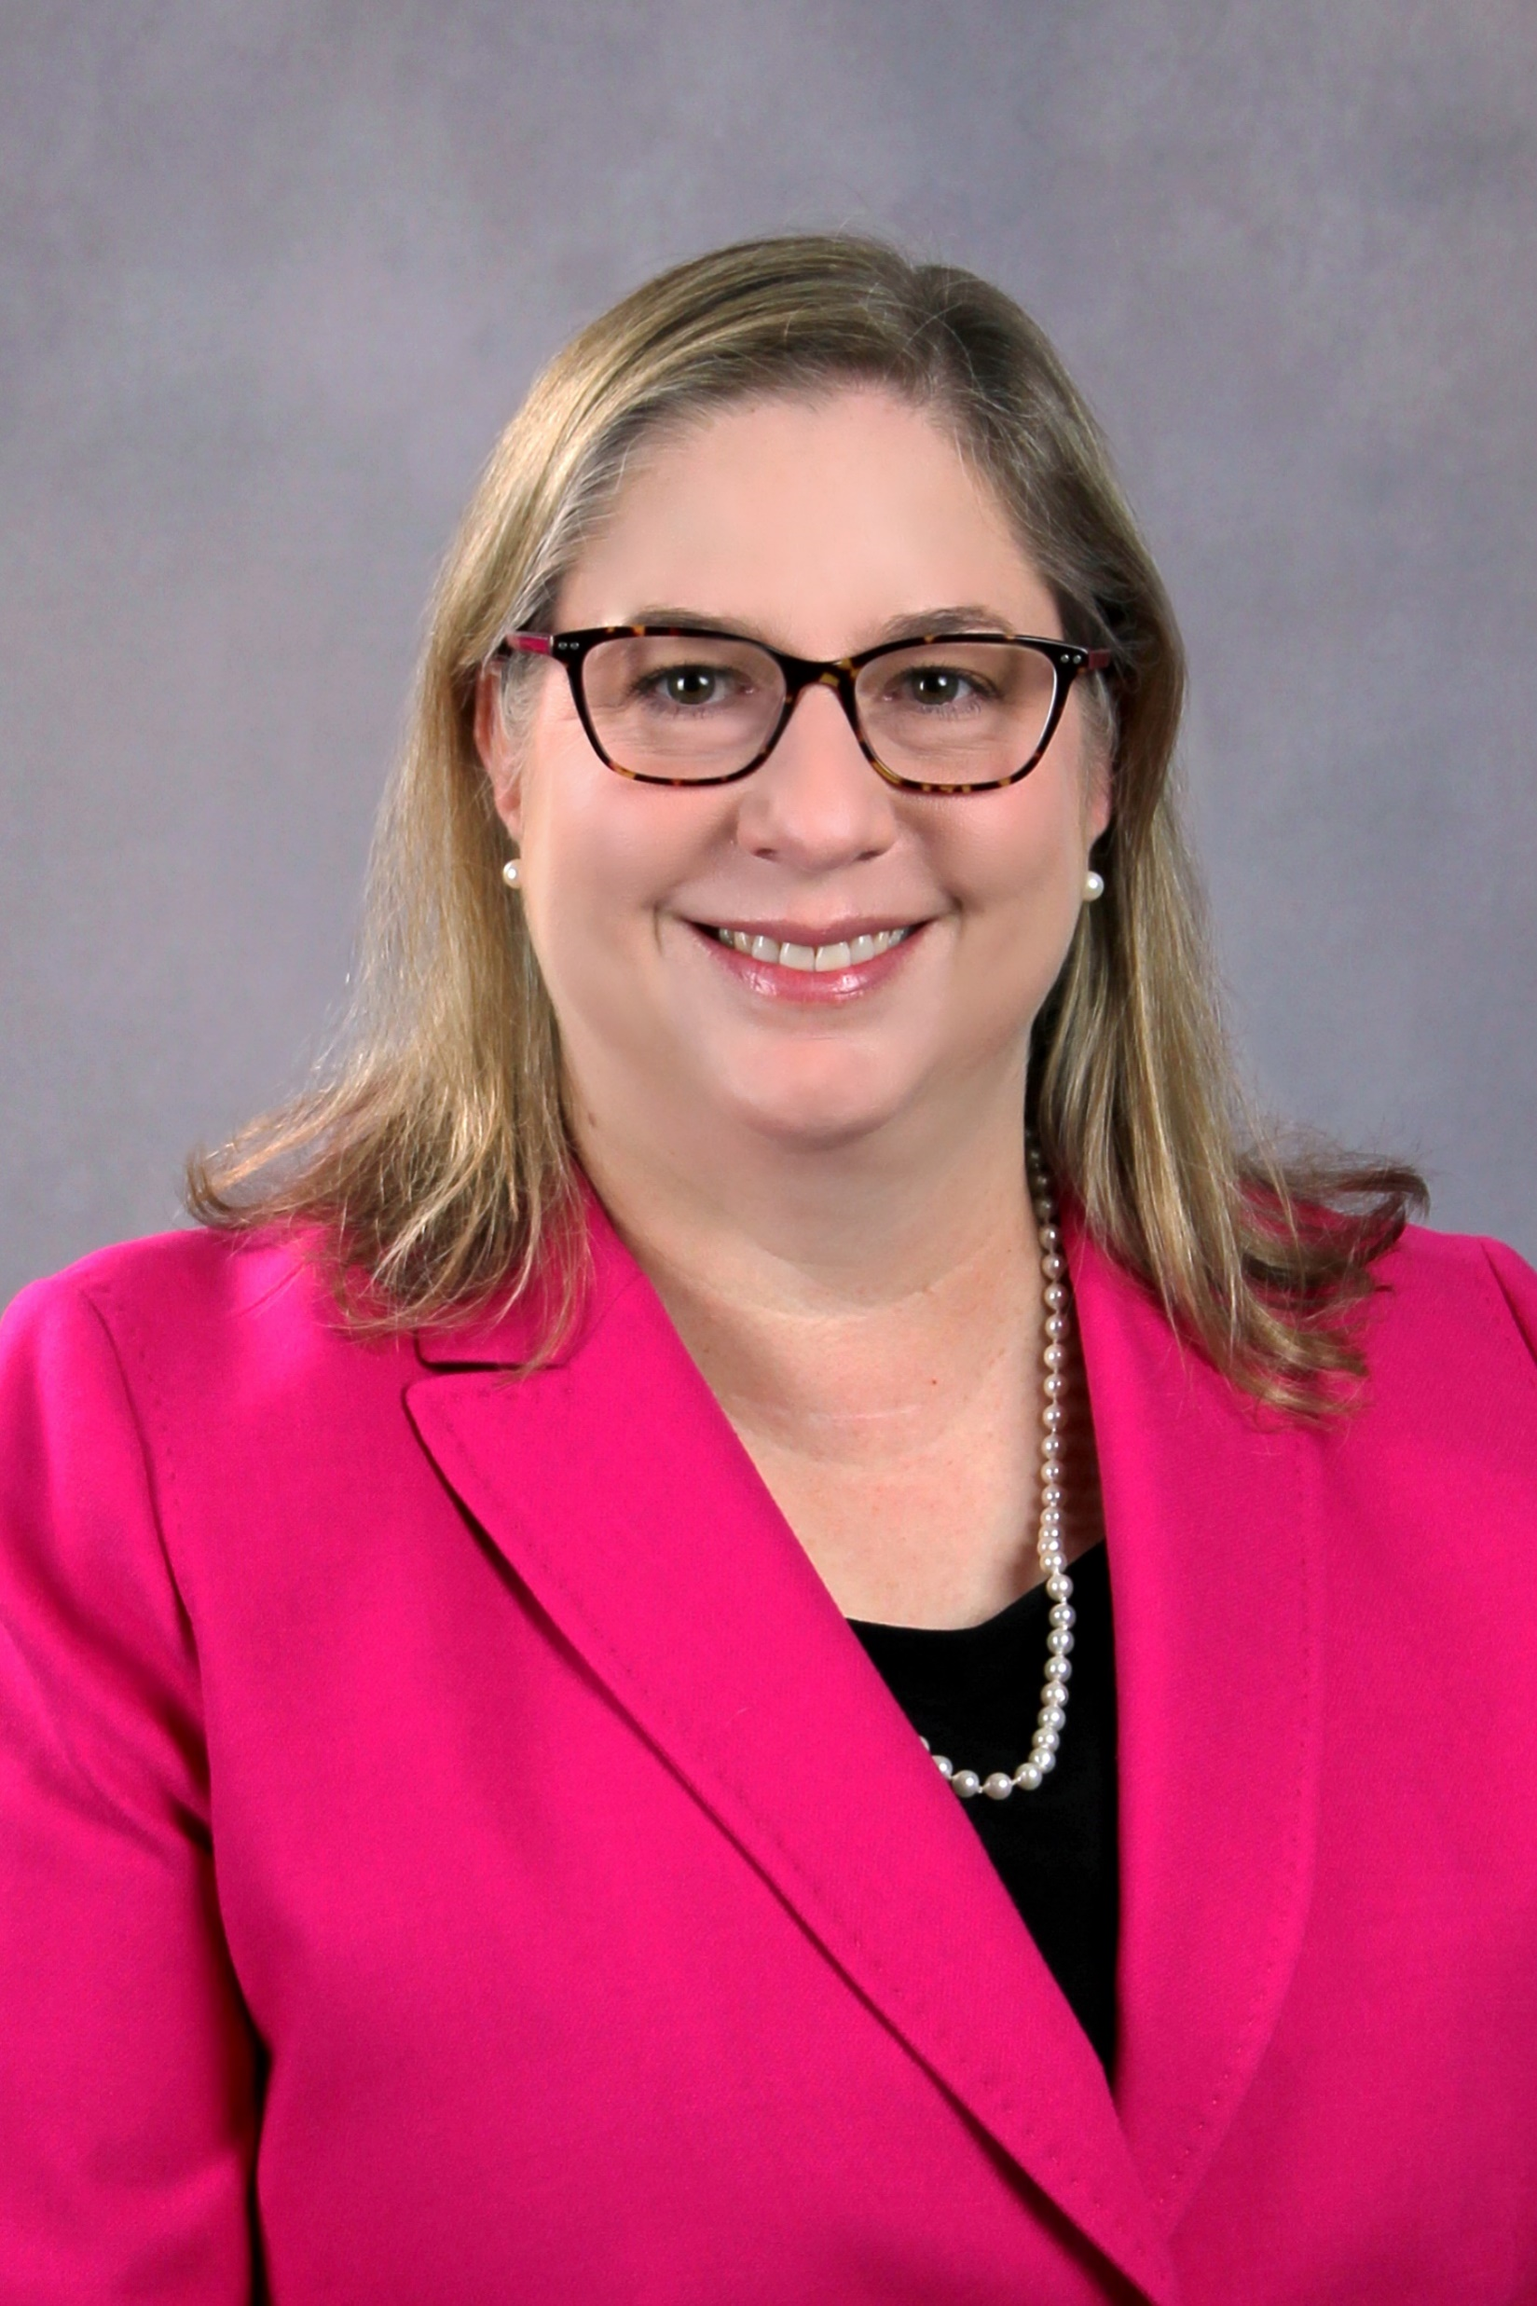

TechOpp Consulting, Inc.
Engineers, PI’s, proposal writers
Bob Fielder
President
Randy Simpson
COO
Leigh Midkiff
Operations Manager
Bill Wilson
Project Manager
Andrea Hill
Senior Project Manager
Mary Ann Bonadeo
Senior Project Manager
Brian Philips
Project Manager

Slide 4




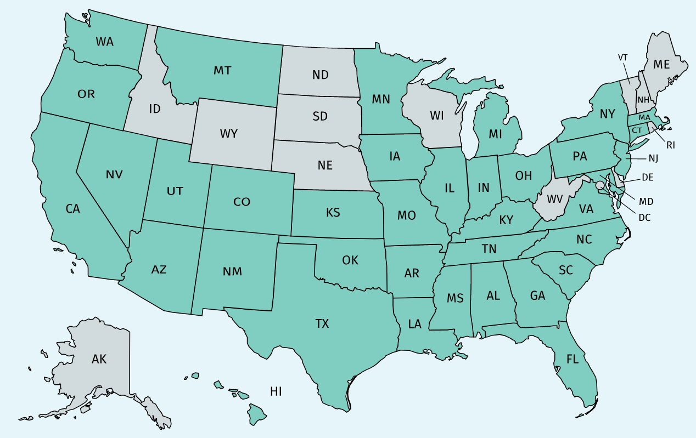
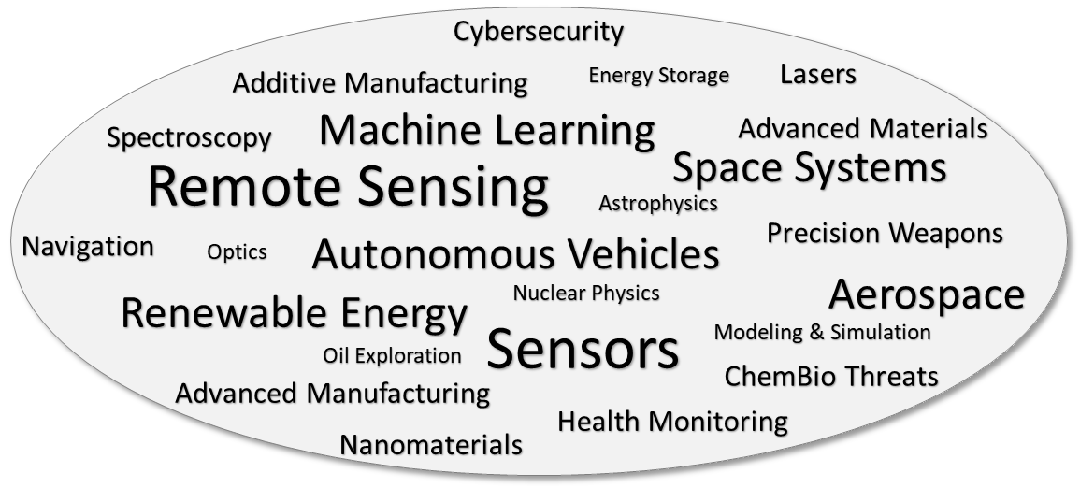
Our Mission
Moving technology from ideas to products
Identify
Opportunities
Secure
Funding
Establish
Partnerships
Over 300 Clients | 37 States
Spanning the STEM Spectrum

Slide 5







What We Provide
Technology transition, proposal support, training
Vet opportunities with small businesses--gratis
Proposal Development
Technology Transition
Typically Gov’t Funded
Identify Specific Targets
Technology Profile
Phase I
Phase II
Transition Partners
Technology Insertion
Client Win Rates exceed National Averages
Emphasize Direct Engagement with End Users

Slide 6







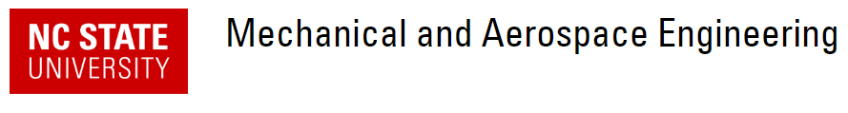


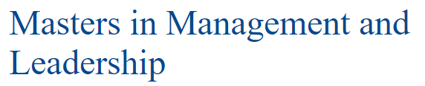

Randy’s bio
Aerospace & Defense
Go Pack!
OMS

Slide 7
Convenient SBIR/STTR links
Note: website addresses have short “shelf life!”
Dept. of Defense (DoD): SBIR — Solicitations
Dept. of Health and Human Services/National Institutes of Health (HHS/NIH): SBIR — Solicitations
Dept. of Energy (DoE): SBIR — Solicitations
National Science Foundation (NSF): SBIR — Solicitations
National Air and Space Administration (NASA): SBIR — Solicitations
Dept. of Homeland Security (DHS): SBIR — Solicitations
Dept. of Education: SBIR — Solicitations
Dept. of Transportation (DoT): SBIR — Solicitations
Dept. of Agriculture (USDA): SBIR — Solicitations
Environmental Protection Agency (EPA): SBIR — Solicitations
National Oceanic and Atmospheric Administration (NOAA): SBIR — Solicitations
National Institute of Standards and Technology (NIST): SBIR — Solicitations

Slide 8
SBIR/STTR Program Success Stories
Is the SBIR program beneficial to small business?

Slide 9

Program Success
Increase GNP
Small Business Innovation Research
Small Business Technology Transfer
To date, the Program has resulted in
  70,000 issued patents
  Close to 700 public companies
  Approximately $41 billion in venture capital investments
This is a successful program and is reauthorized through 2022
Local SBIR success story follows…

Slide 10
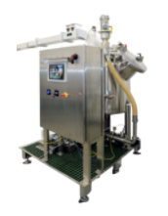
SinnovaTek, Inc.
Raleigh, NC
USDA SBIR
Microwave food processor
TechOpp client
Small Business Innovation Research (SBIR) funding was integral in validating the base technologies behind the Nomatic processing system.
SinnovaTek is having a significant impact on the lives of young children a world away in Sub-Saharan Africa
  Where almost half of children under 5 suffer vitamin A deficiency
  Thanks to their Nomatic processing system, and locally-available sweet potatoes
The Nomatic allows for high quality small scale, distributed processing for high acid and low acid shelf-stable foods. Thus far, similar processing systems have only been available at large scales, with high minimum order quantities.
This system is being built around the concept of small-scale aseptic food manufacturing, and servicing customers who would not otherwise have access to high quality food processing
SinnovaTek has seen approximately $1.5 million in sales, with 5 systems sold in 2019, another 6 projected to be sold in 2020; and, $1.3 million in further funding and investments.

Slide 11

[your company]
[agency]
[your company] can do this!
Understand the benefit of SBIR/STTR funding
  Non-diluted
  Achieves non-competitive opportunities
And relationships
  This is as important—who you know and who they know
  Build those relationships towards future business

Slide 12
How Do I Begin?

Slide 13

Eligibility Requirements
How is a “Small Business” defined?
https://www.sba.gov/document/support--table-size-standards
“Small Business Concern (SBC)”
  Be a for-profit business of any legal structure
  Be independently owned and operated
  Not be nationally dominant in its field
  Be physically located and operate in the U.S. or its territories
Self-Certify
  Size standards are by Industry/NAICS Code
  Or by number of employees

Slide 14

Define Yourself
In terms applicable to DoD technology
TechOpp helps small businesses connect the dots between your core competencies and SBIR topics--gratis
What are your key competencies?
  Define in a few “key words” that can be used to search for funding
  Where do you excel as evidenced by Customer Testimonials?
What are your strategic goals as a company?
  Technological (not financial for this exercise)
  Are you staffed to achieve these goals?
Are you published and/or active in Industry Groups
  How do your prospective customers learn about you?
  How “outgoing” are you toward building business relationships?

Slide 15

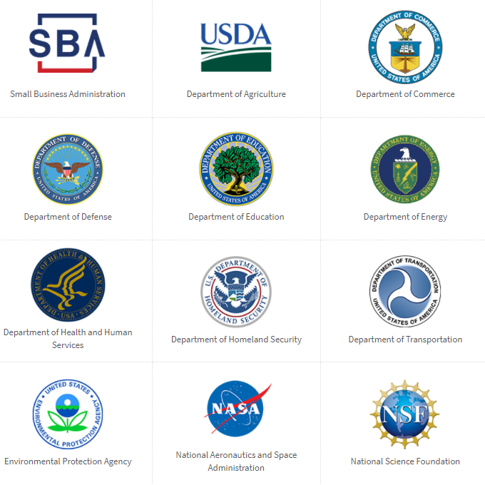
Find a Home
Who is interested in your technology?
Research the Agencies
  Who does what you do?
  Find a group
  Find a person
  Reach out an connect
Proposals from “known entities” are more likely to be awarded
  All else being equal
Hard, time-consuming work!

Slide 16

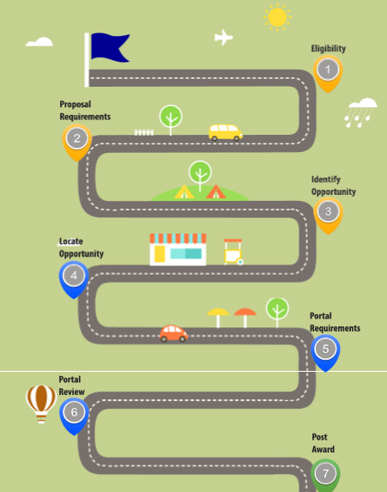
How to Get Started
Registrations first!
Get an overview of the SBIR/STTR programs
Learn the steps in the application process
Explore tutorials
Attend an event
Find local assistance
Phase 0 & State Matching Programs
Get inspired by other company stories
Confirm eligibility
Scams, Spam, and Fraud

Slide 17
Proposal Submission

Slide 18
Proposal Basics
Applies to all proposals
Key Take-away
Proposals are not read—they are evaluated
  Make it easy for the Evaluator to find the criteria
  Focus on the criteria wording and mimic that in your text
Compliance with instructions is the first gate
  Non-compliance = Rejection
  Follow instructions precisely in order, using their language
Understand how your solution impacts the End User: Compelling Offer
  Emphasize operational improvements possible
  Learn this from talking to Topic Author and/or Prime Contractors

Slide 19

How proposals are scored
Not read, evaluated!
Broad Agency Announcement
Start with the Phase I Evaluation Criteria, Section 6 of the BAA
  Note the “descending order of importance” statement
  This defines the scoring allocation to each criteria
Imagine yourself scoring a proposal using these criteria
  How would you approach it? What is a reasonable approach?
  Define the terms for the Evaluator: “sound, innovative”
  Write your sections so the criteria are easily found and scored
  Make it easy on the Evaluator—you do not want an angry one!

Slide 20

Proposal Lifecyle
Multi-Step Process
Start now
Pre-solicitation marketing
Review topic description
Talk to topic author
Bid/no bid decision
Compliant outline
Compelling message
Bulleted text
Transition partner/LOS
First draft
Red Team Review
Submit
Submission Party
Lessons Learned Meeting
20
15
Timeframe typically 6-8 weeks
60
30
5
50
35
1
45
40
-3
-3
Days until delivery

Slide 21

Proposing to the DoD
Unique SBIR strategy
DoD 3 cycles annually
“Dot1” Dec-Jan-Feb
“Dot2” May-June-July
“Dot3” Aug-Sept-Nov
DoD typically is looking for a solution to an operational challenge
  Often topic genesis is from the soldier’s need
  Topic Author is documenting this need and requesting solutions
  Important to understand how solution benefits soldier in the field
DoD typically does not consume solution first-person
  More likely to sell through a DoD prime contractor
  And often sell down the Prime Contractor’s supply chain
  Important to identify your customer
However, the DoD will establish the requirements and select the SBIR winner

Slide 22
Commercialization

Slide 23

Bottom Line Up Front
This is hard work!
Talk to topic author
Genesis of topic
Market Research
Does topic identify civilian markets?
What benefit is desired?
Who stands to benefit?
Are the markets growing and how much?
Do I transition through a Prime Contractor?
Is there a program of record?
Who are principals operating in these markets?
Reach out for business relationships and Letter(s) of Support for the Phase I proposal
How will you make money after Phase II?
License the technology to someone in the supply chain?
Contract Manufacture and provide support yourself?
Host the software on your site or a cloud site for user fees?
Clarify that you will investigate these options in both Phase I and Phase II
What will be your TRL at the end of Phase II? <6 need R&D$, >6 need customers

Slide 24

Commercialization Strategy
Targeted
Credible
Specific
Planned
Quantified
TPOC Vision
Understand TPOC’s Vision for Transition
Transition Partner
Validation
End Game
Monetization Plan
Production
Target Program / Mission
CONOPs
Production Plan
IP Protection
System Integration
Notes:
No unsubstantiated claims!
Start with topic author, talk to them about need, your solution, etc, but don’t forget to ask about commercialization/ preferred technology transition path.
Ask topic author: do I need a transition partner?

Slide 25
Adding Supplemental Funding

Slide 26


Technical And Business Assistance (TABA)
Focused on transitioning new technology to products
Engage with Customer
Technical Monitor
DoD Programs
Federal Programs
Just ask for it in your proposal Get a commercialization expert on your team
Markets and Industry Leaders
Market Research
Lead Organizations
Federal Funding
Phase I Budget
Recruit Transition Partner
Identify Partners
Develop Scope
Transition Plan
$
$
TABA Funding
$
Phase II Commercialization Strategy
Develop Content
Develop Plan
Market Data
Up to $6.5k for Phase I

Slide 27

SBIR Training Topics
Free Webinars Available
https://techoppconsulting.com/
DoD Agency Topics overview
How to research a topic and prepare to propose
Engaging with Collaborators
Spotting a “Wired Topic”
Bid/No-Bid Decision
Weigh the cost of bidding & proposal strategy/basics
Efficient proposal preparation
Common Debrief Comments
Topic Search Tool—gratis support to small businesses

Slide 28
Randy Simpson, COO
Randy.Simpson@techoppconsulting.com
540.744.5854

