Slide 1
Taking The Long View

Slide 2
Having your item included as a budget line item is the holy grail (sorta).
The longer-term perspective has the focus to an item that will be “managed” by a PM.
There are dozens of PMs for procurement within each of the services.
There are dozens of PMs for R&D within each of the services.
There are a number of “DoD-Wide” programs, and/or those programs where there may be a “Joint” office which will act in the interest of multiple services. Examples include:
Joint PM for the F-35 (sometimes referred to as The Joint Strike Fighter)
JPEO-CBRNE (Chem-Bio capabilities)
The Army is the Executive Agent for food science and rations
Much of the medical R&D
So, you will need to know who has jurisdiction for your item, in each of the services.

Slide 3
FY 2021 and FY 2022 Total Funding by Appropriation Title
$350.0
$300.0
$290.4
$283.4
$250.0
$200.0
_{$162.3} $167.3
$150.0
$141.7
$133.6
_{$106.4} $112.0
$100.0
$50.0
$9.9
$11.7
$0.0
Military Personnel O&M
FY 2021 Enacted
Procurement
RDT&E
Military Construction & Family Housing, Other
FY 2022 Request
Numbers may not add due to rounding
FY 2022 Request: $715 billion

Slide 4
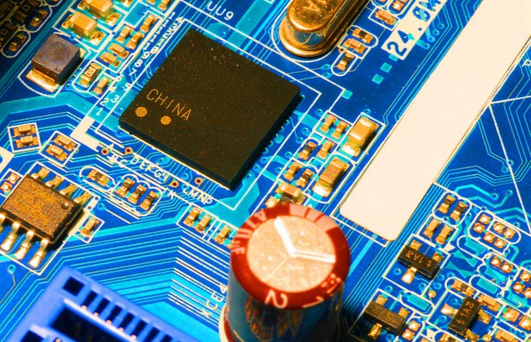
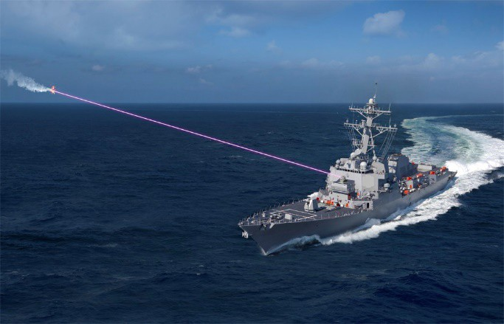
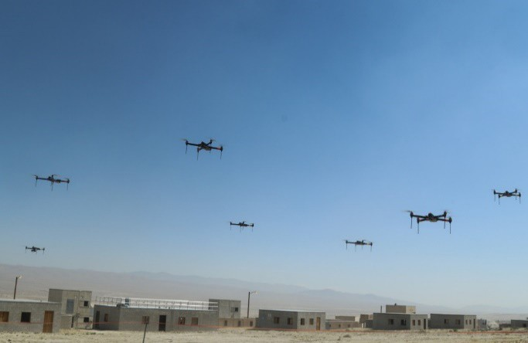
Innovate and Modernize
S&T and Advanced Capability Enablers for FY22 Budget
$112.0 billion RDT&E budget is the largest ever
Increases 5.1% over FY 2021 request
Science & Technology: $14.7 billion
4.1 percent increase over FY 2021 request
Maintains Basic Research at $2.3 billion
Microelectronics: $2.3 billion
Improves assurance, availability, and access to advanced capability microelectronics
Artificial Intelligence (AI): $874 million
Maintains AI as a top technology modernization priority
Over 600 AI efforts now underway
5G: $398 million
Leverages 5G technologies and networks for military applications
Innovate at speed and scale to match the dynamic threat landscape
9

Slide 5
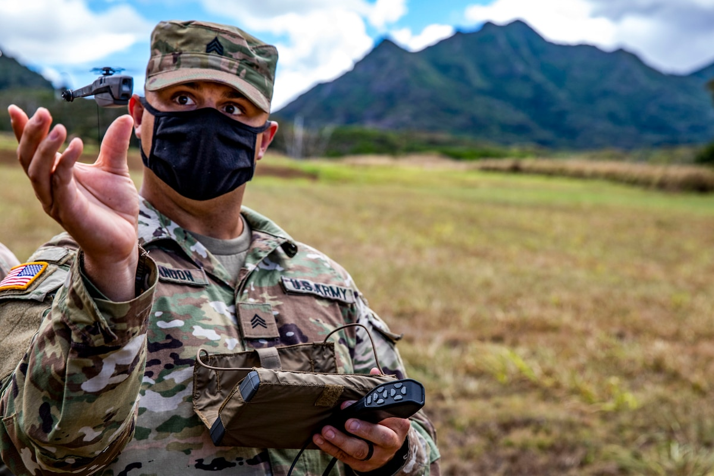
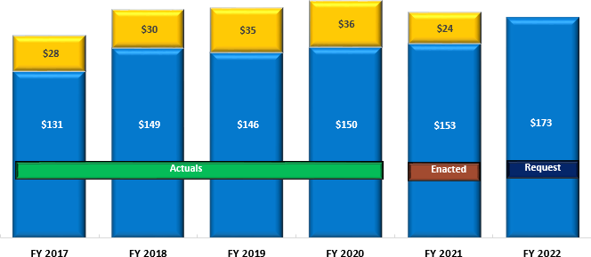
Army Budget: $173B
Direct War and Enduring Costs Included within base budget
Base
Direct War Costs Enduring Costs
($B)
154.5
10.4
8.0
FY 2022 Army budget is committed to sustaining readiness gains and continuing the Army’s modernization efforts within its topline
Over the last three years the Army internally resourced its modernization priorities
FY 2017 – FY 2022 ($B)
Topline
$179 $181 $186
$177 $173
$159
Army Requires Timely, Adequate, Predictable & Sustained Funding
Notes:
Presenter
2021-05-28 17:59:56
--------------------------------------------
Update Asterisks verbiage

Slide 6
Know The Budget Cycles
Year of Execution
FY 2022; starts October 1st, 2021 and ends September 30th, 2022.
Submitted back in the Spring of this year (delayed due to a change in administration).
Been considered in committee, marked, awaiting vote in each chamber.
Will not be passed by October 1st for the new budget year.
Continuing Resolution until December 2021 will be proposed.
Budget Year
FY 2023 (1 October 2022 to 30 September 2023)
Due to Congress 1st Monday of February, 2022
Being assembled as we speak today
Mostly complete by holiday breaks, this year, 2021.
Future years
FY 2024 and beyond
May well be that a first solid opportunity for influence is fall of 2023 for inclusion in FY24 budget

Slide 7
BUT, THERE ARE OTHER WAYS…
Acquisition reforms and increased awareness for agility has been recognized in DoD
OTAs (Other Transaction Authorities)
Often administered through various consortiums
Quick turnaround from announcement to awards
Simplicity in submissions, usually 3 steps
Cycle can be as rapid as 6-8 months
Focused on prototype deliverables (implies your technology is somewhat mature)
Some have authority for follow-on manufacturing contracts
BAA (Broad Area Announcement)
A standing solicitation that can be on the shelf for a number of years
Open request for new ideas and technologies
Current Examples include advanced fabrics and CBRNE; there are others.
Congressional “Adds”
Ron Houle
President
Pivot Step Consultants, LLC
Ron.houle76@gmail.com
914-806-3775

